Slide 1
Analyzing Border Crossing Entry Data
Name : SAI KRISHNA KUNKU
Pace email address : SK01387N@pace.edu
Class Name : Practical Data science
Course Number: 667
University Name : PACE UNIVERSITY

Slide 2
Agenda
Executive summary
Data Source
Dataset Size
Time period
Dataset link
EDA Section
Modeling methods section
Findings section
Recommendations

Slide 3
Executive Summary
Problem Summary: Analyzing historical border crossing data to identify seasonal trends and key geographical locations of illegal crossings.
Solution Summary: Utilizing predictive modeling to forecast trends and prepare for potential increases in border crossings.

Slide 4
Data Section
Data Details
Data Source: Bureau of Transportation Statistics (BTS) Border Crossing Data collected by U.S. Customs and Border Protection (CBP) at ports of entry.
Sample Size: The dataset includes records of inbound crossings at the U.S.-Canada and U.S.-Mexico border at the port level, covering a substantial number of observations.

Slide 5
Time Period: Data spans multiple years, capturing historical border crossing patterns and trends.
Inclusions/Exclusions: The dataset includes data for trucks, trains, containers, buses, personal vehicles, passengers, and pedestrians entering the United States. Outbound crossings are not captured in the dataset.
Important Notes:
Latitude and longitude coordinates are included to facilitate geospatial analysis and hotspot identification.
The dataset may contain missing values or errors, which could impact the accuracy of analyses.
Dataset link: https://data.bts.gov/Research-and-Statistics/Border-Crossing-Entry-Data/keg4-3bc2/data

Slide 6
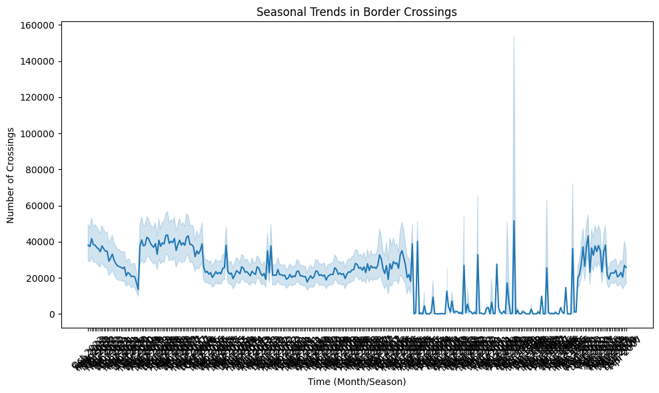
EDA
Seasonal Trends in Border Crossings
This visualization illustrates the seasonal patterns in border crossings, highlighting periods of increased activity. Understanding these trends can help identify peak seasons for illegal border crossings and inform resource allocation and enforcement efforts.

Slide 7
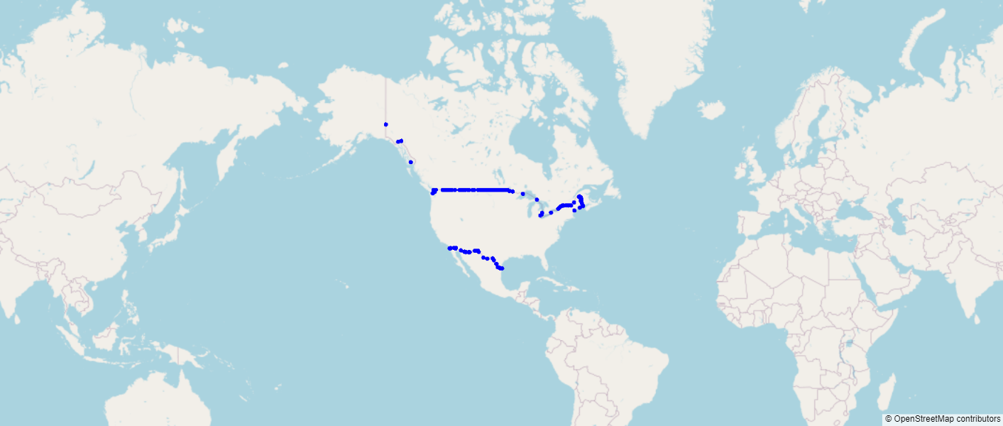
Geographical Distribution of Crossings
This visualization provides insight into the geographic areas experiencing higher instances of illegal border crossings. Hotspots are identified, aiding in the targeted deployment of law enforcement resources and strategic planning for border security.

Slide 8
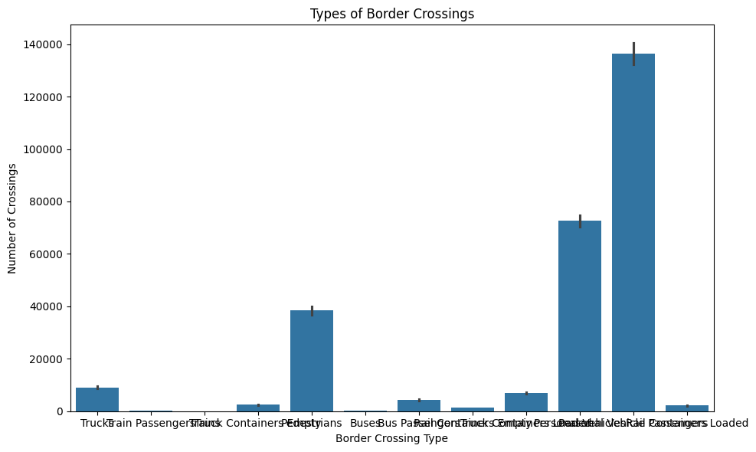
Types of Border Crossings
This visualization displays the proportion of different types of border crossings, highlighting the most common modes of entry. Understanding the composition of border traffic can inform policy decisions and resource allocation for border management.

Slide 9
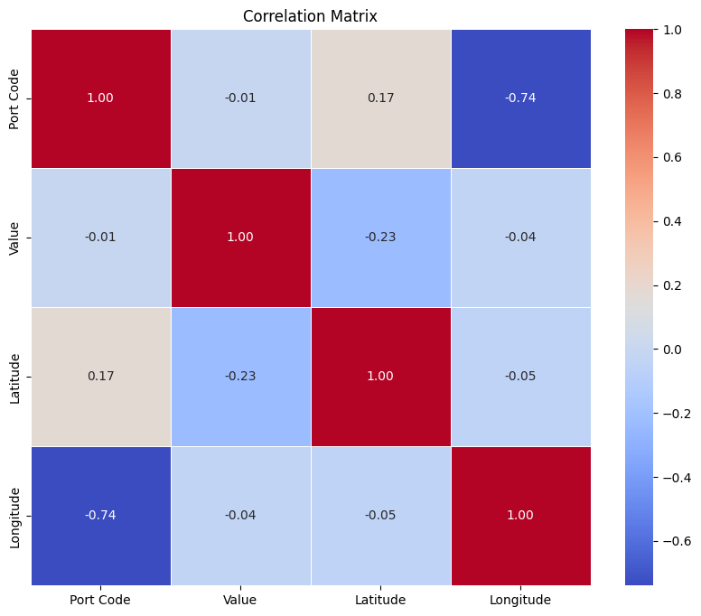
Correlation Analysis
This visualization examines the relationship between various factors and border crossings, identifying significant correlations. Insights gained can inform predictive modeling and intervention strategies to mitigate illegal crossings.

Slide 10
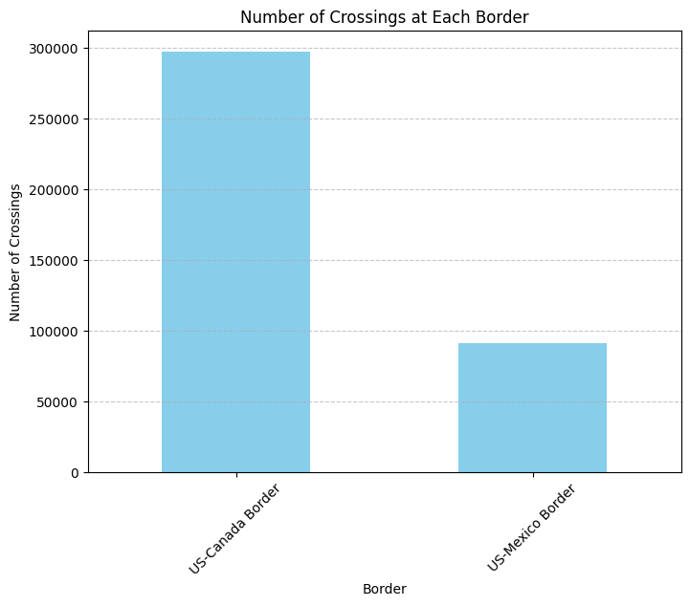
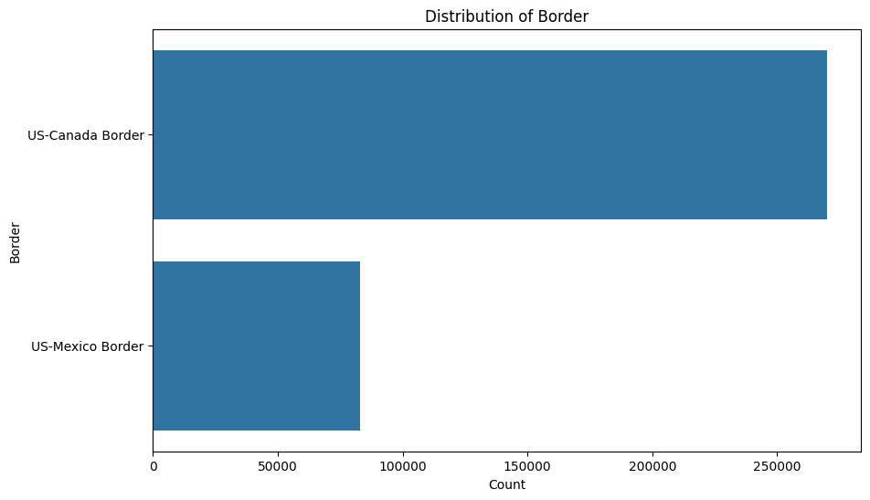
EDA Section
Number of Crossings at Each Border
Distributions of Border

Slide 11
Modeling Methods Section
Trends in Border Crossings
What is it?: The outcome variable represents the number of border crossings over time, which is what we're trying to predict.
Why it matters?: Understanding trends in border crossings helps in resource allocation and proactive planning for border security.
Features
Rationale for Choosing Features: The features chosen for the model include:
Time of Year: Seasonality in border crossings.
Geographical Location: Influence of port of entry on border crossings.
Type of Crossing: Different modes of entry such as trucks, trains, and pedestrians.

Slide 12
Model Type: Time-Series Forecasting
What is it?: Time-series forecasting is a method used to predict future values based on past observations.
Why this Model?: Time-series forecasting is suitable for our data as it can capture trends and seasonality in border crossings over time

Slide 13
Findings section
Title: Key Insights from Modeling Analysis
Modeling Findings:
Seasonal Trends in Border Crossings:
The analysis revealed distinct seasonal patterns in border crossings, with peaks during certain months or seasons. Understanding these trends can help allocate resources more effectively during high-traffic periods and plan enforcement strategies accordingly.
Geospatial Distribution of Crossings:
Hotspot analysis identified specific geographical locations experiencing higher instances of illegal border crossings. This information can guide targeted deployment of law enforcement resources and strategic planning for border security measures.

Slide 14
Types of Border Crossings:
Analysis of the types of border crossings revealed the composition of border traffic, highlighting the most common modes of entry. This understanding informs policy decisions and resource allocation for border management efforts.
Correlation Analysis of Border Crossings:
The correlation analysis identified significant relationships between various factors and border crossings. Insights gained from this analysis can inform predictive modeling and intervention strategies to mitigate illegal crossings effectively.
Predictive Modeling for Trends Forecasting:
The predictive modeling approach successfully forecasted future trends in border crossings, providing valuable insights for proactive planning and response. The model's accuracy in predicting trends enhances preparedness and decision-making for potential increases in border transportation.

Slide 15
Recommendations
Enhance Data Quality:
Given the importance of accurate and complete data for trend analysis and predictive modeling, the organization should invest in improving data quality assurance processes. This includes ensuring data accuracy, completeness, and consistency across all sources.
Continuous Monitoring and Update:
Implement a system for continuous monitoring of border crossing data and update predictive models accordingly. Regular updates enable the adaptation to changing trends and patterns, improving the accuracy of forecasts and decision-making processes.

Slide 16
Technical Next Steps for Data Science Team:
Advanced Model Development:
Explore the possibility of building more advanced models, such as predictive machine learning models or ensemble methods
Data Expansion and Integration:
Consider collecting additional data sources to expand the scope of the project and address different business problems related to border security and management. Integration of diverse data sets, such as demographic data or social media sentiment analysis, can provide deeper insights and enhance the effectiveness of predictive modeling efforts.

